Slide 1
DAC (District Advisory Committee) Screen Mockups

Slide 2
Roles
Admin
Principal and DAC_SC
Campus based employees
Central Office employees

Slide 3
Admin screens

Slide 4
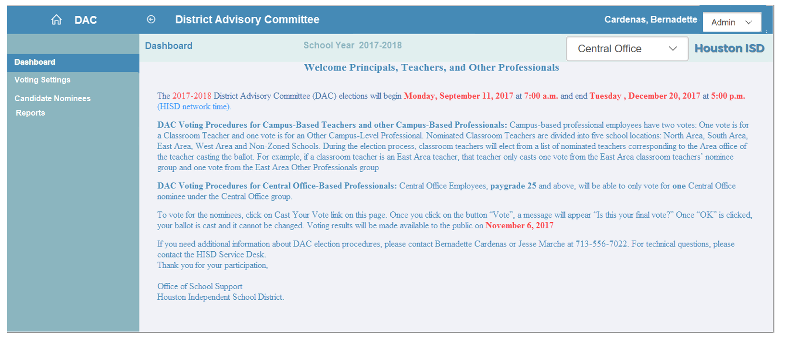
Admin Screen- Dashboard

Slide 5
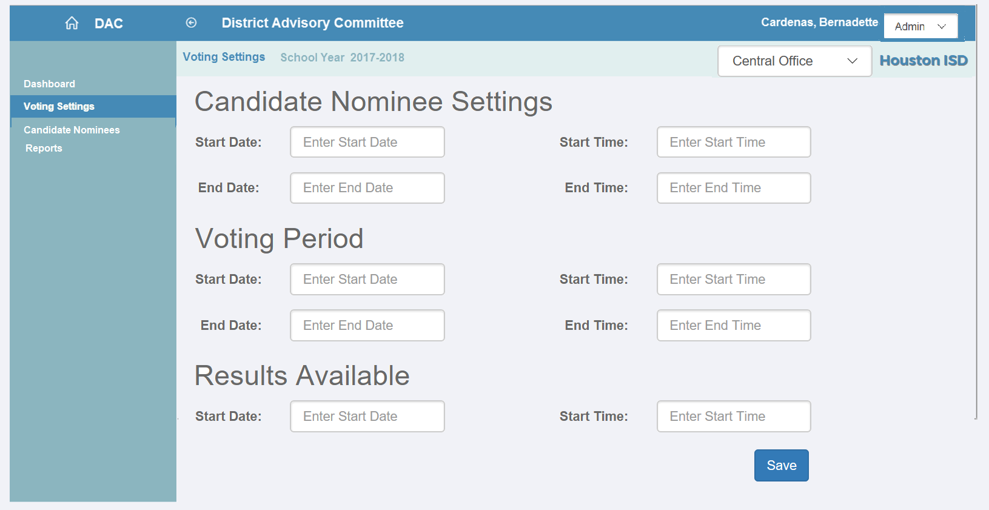
Admin Screen- Voting Settings

Slide 6
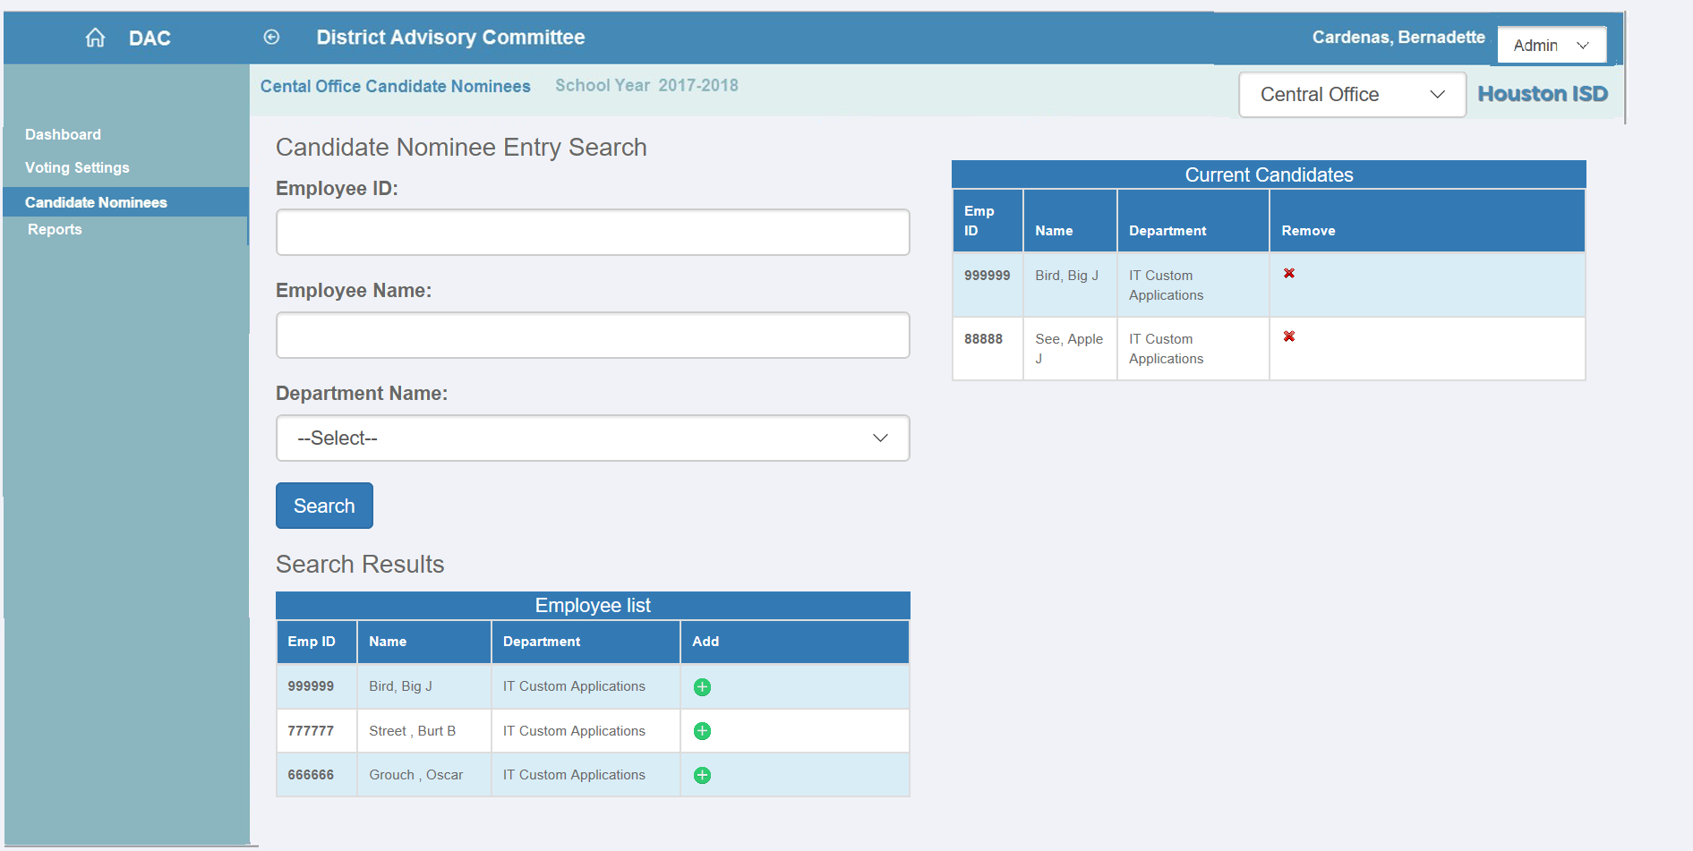
Admin Screen- Candidate Nominees- Central Office

Slide 7
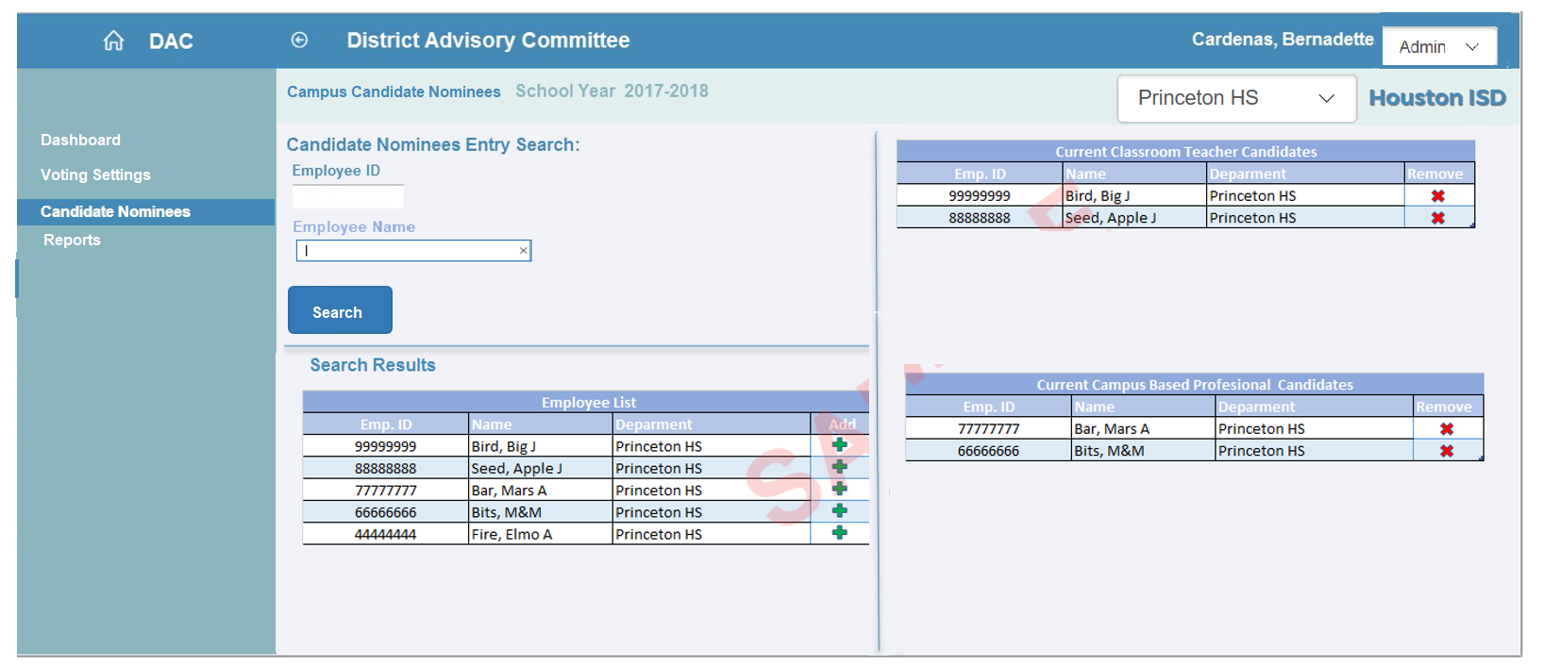
Admin Screen- Candidate Nominees- Campus

Slide 8
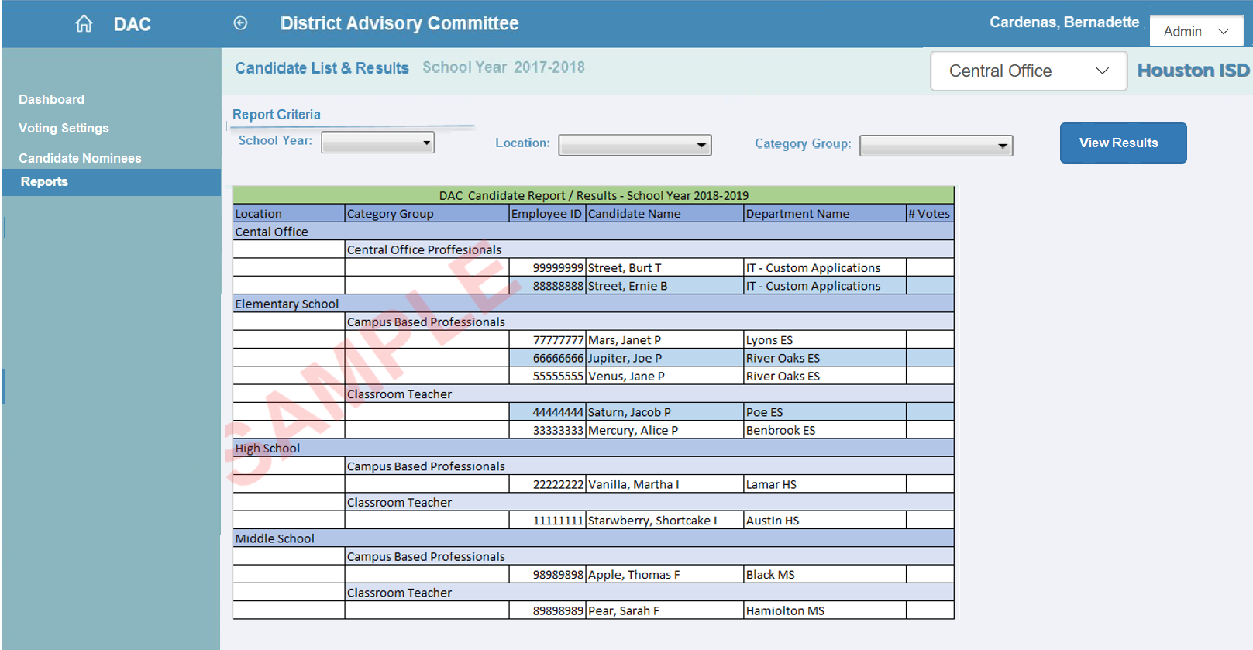
Admin Screen- Reports

Slide 9
Principal and DAC_SC Screens

Slide 10
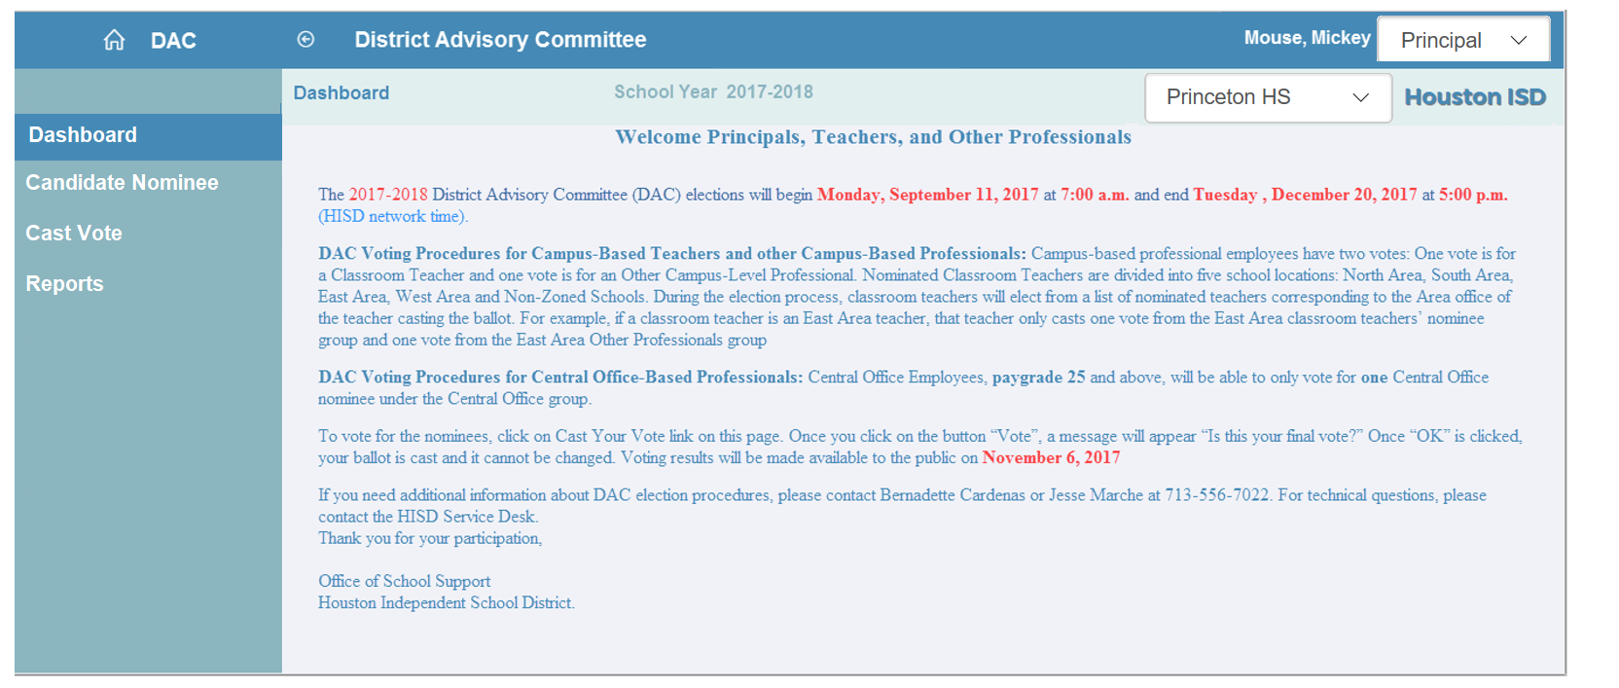
Principal Screen- Dashboard

Slide 11
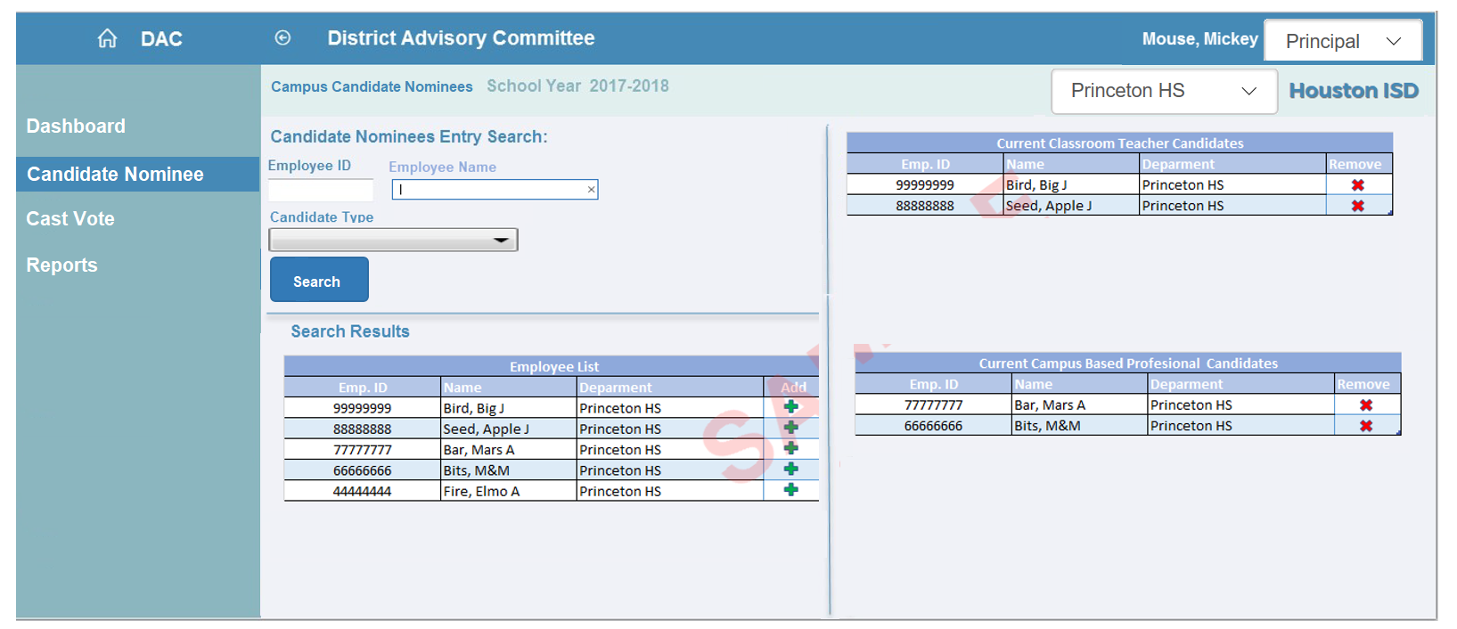
Principal Screen- Candidate Nominee

Slide 12
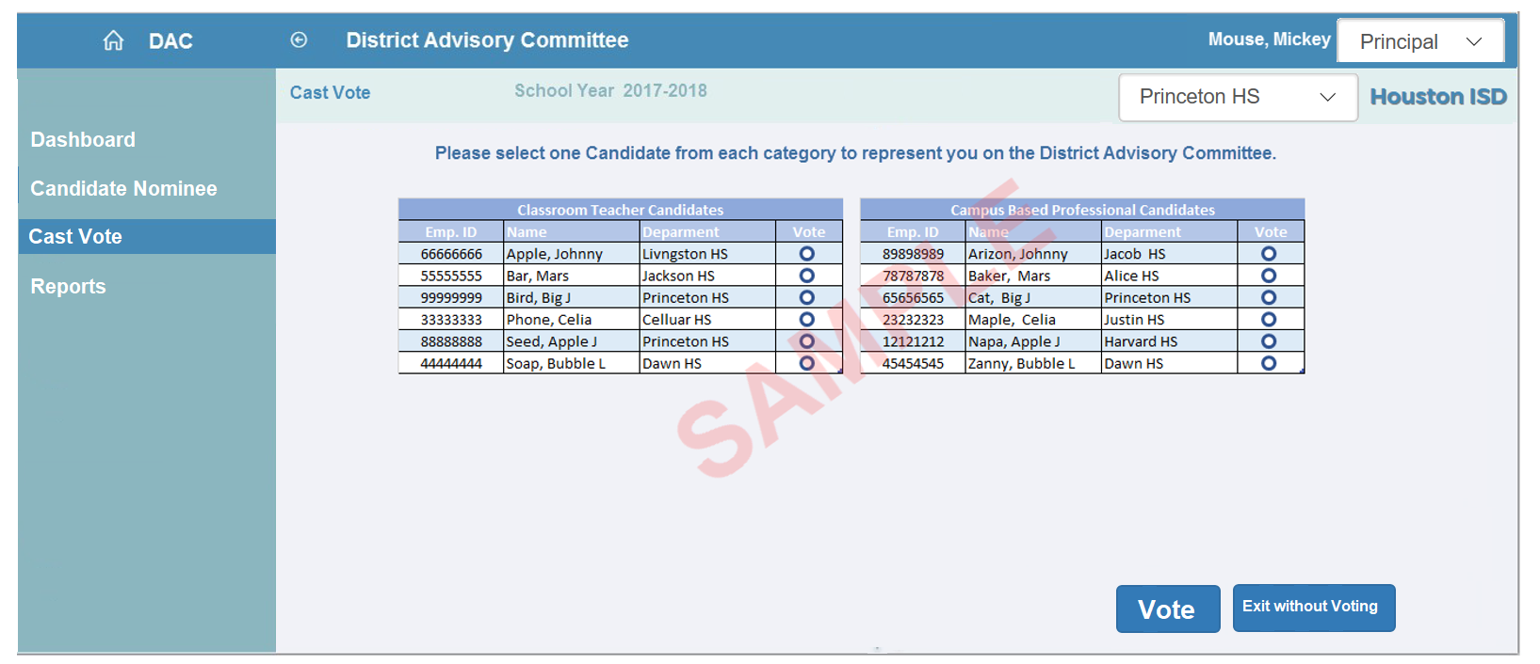
Principal Screen- Cast Vote

Slide 13
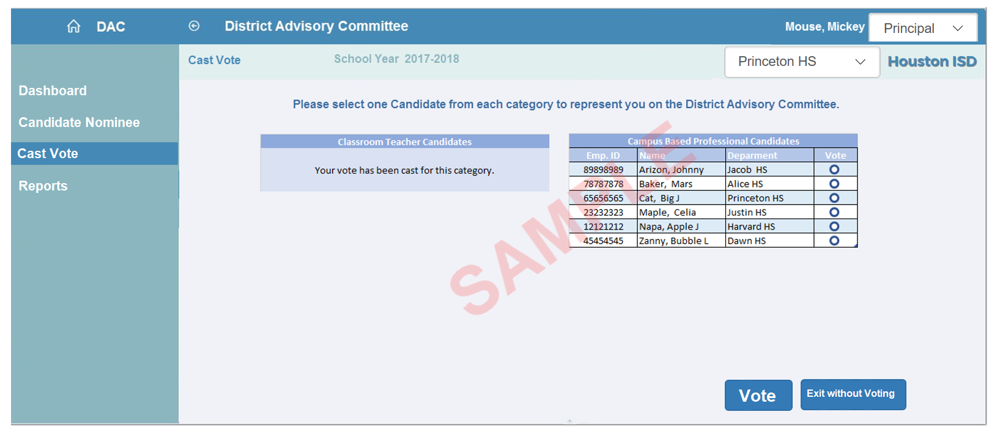
Principal Screen- Cast Vote

Slide 14
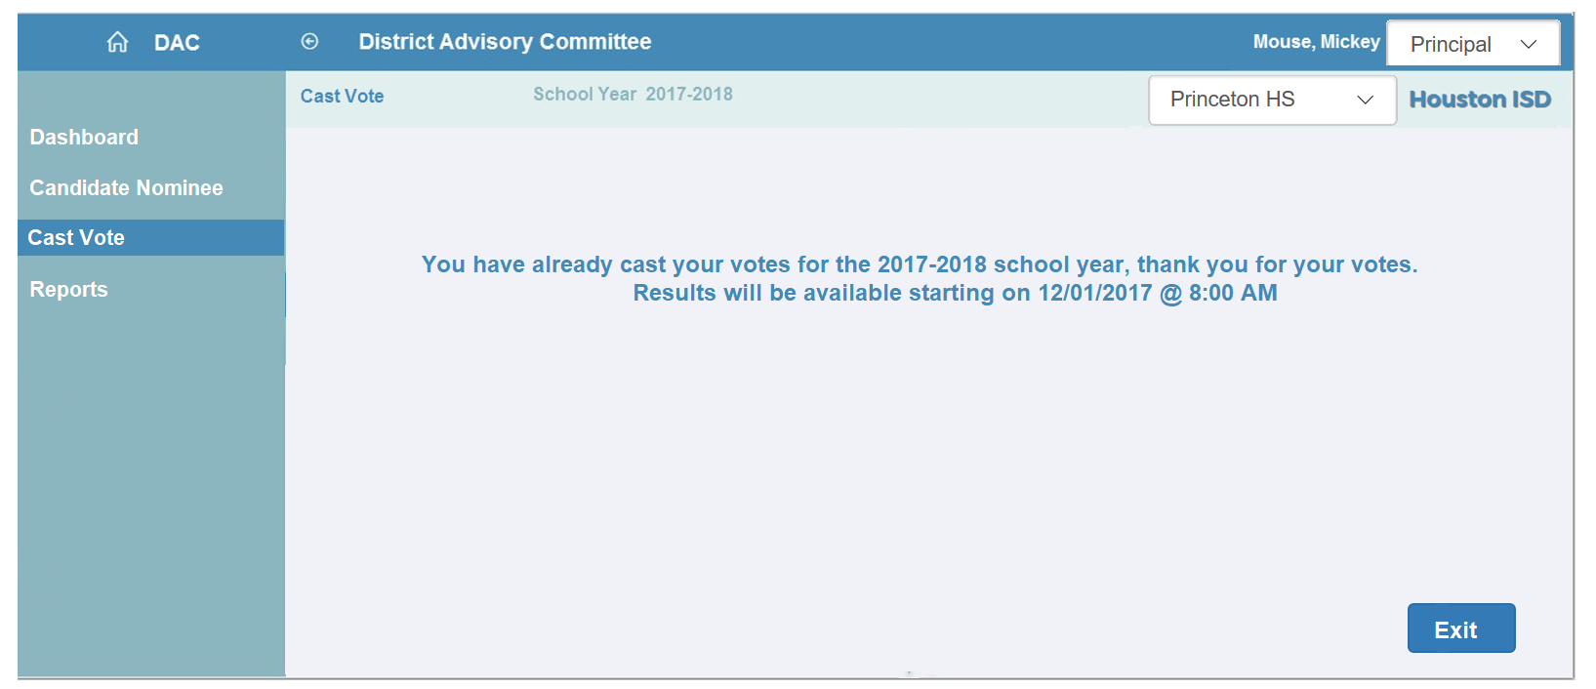
Principal Screen- Cast Vote

Slide 15
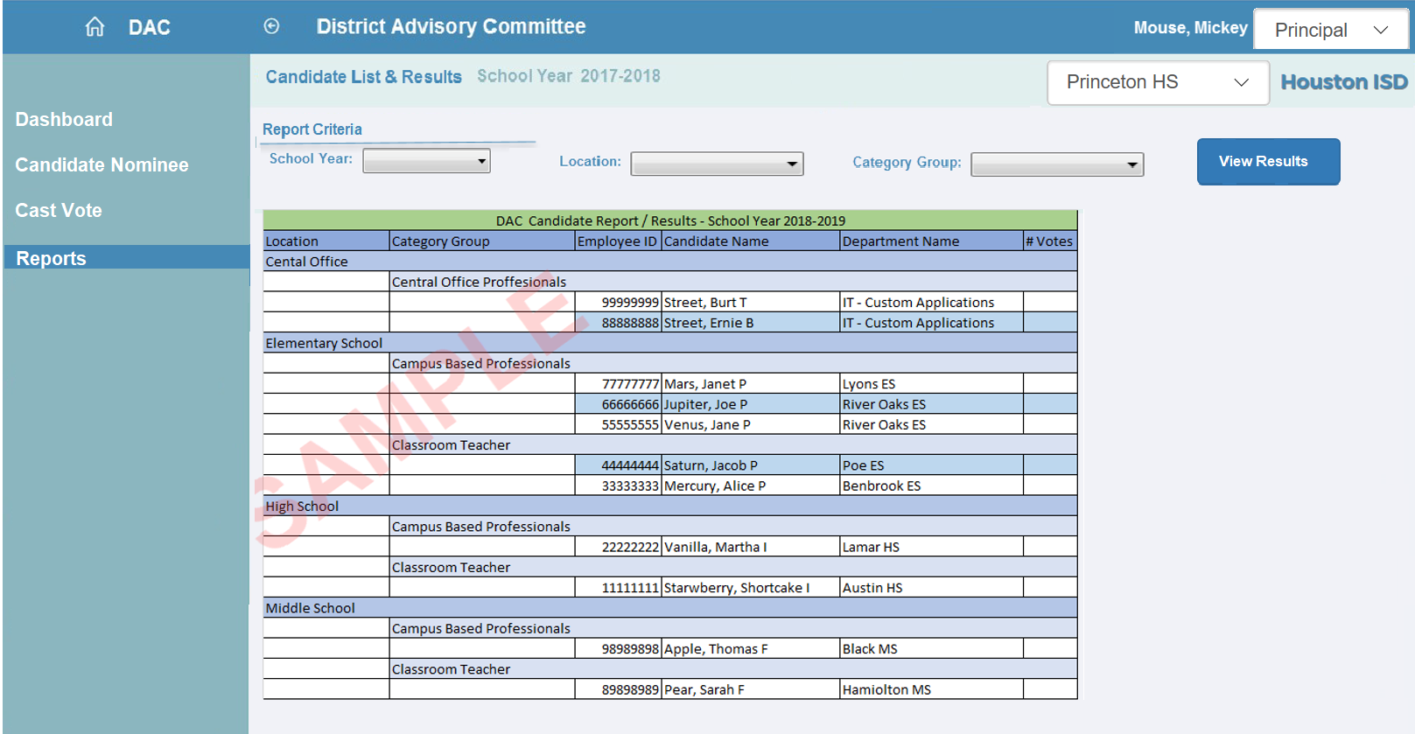
Principal Screen- Reports

Slide 16
Campus Based Employees

Slide 17
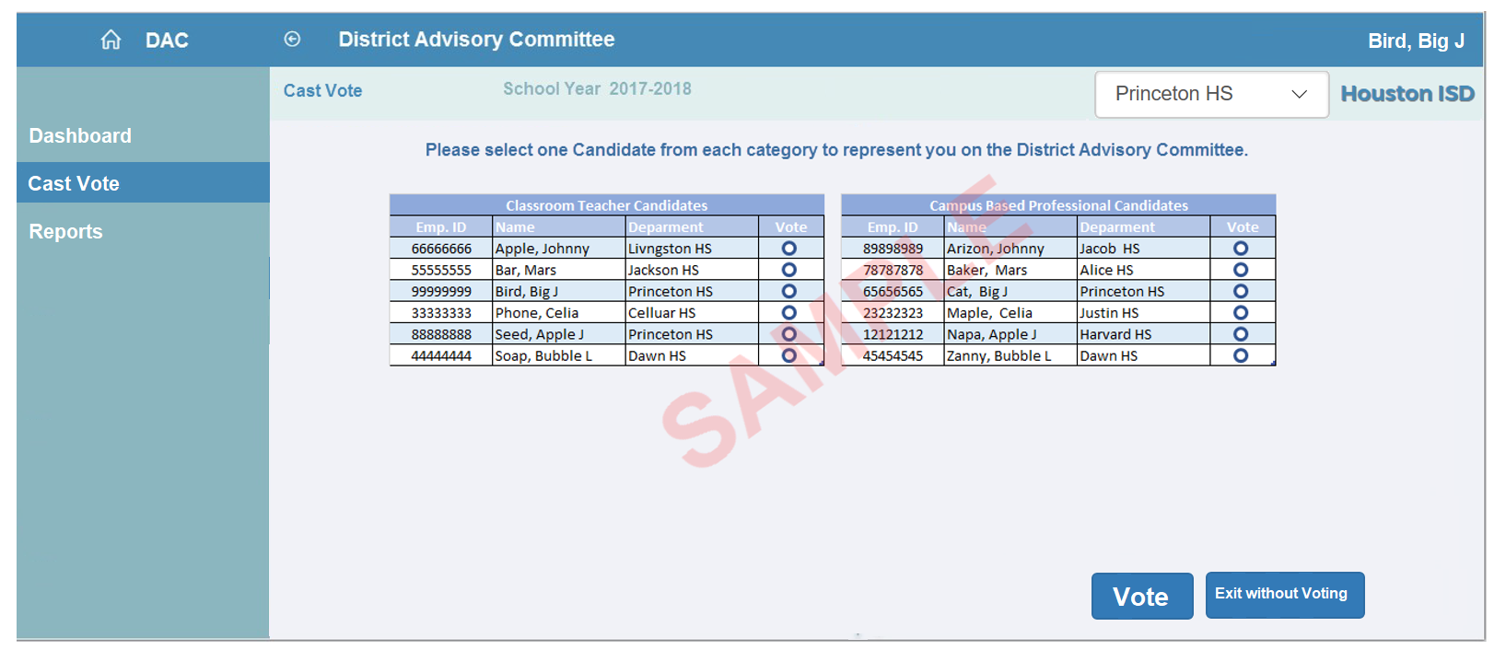
Campus Based Employees-Cast Vote

Slide 18
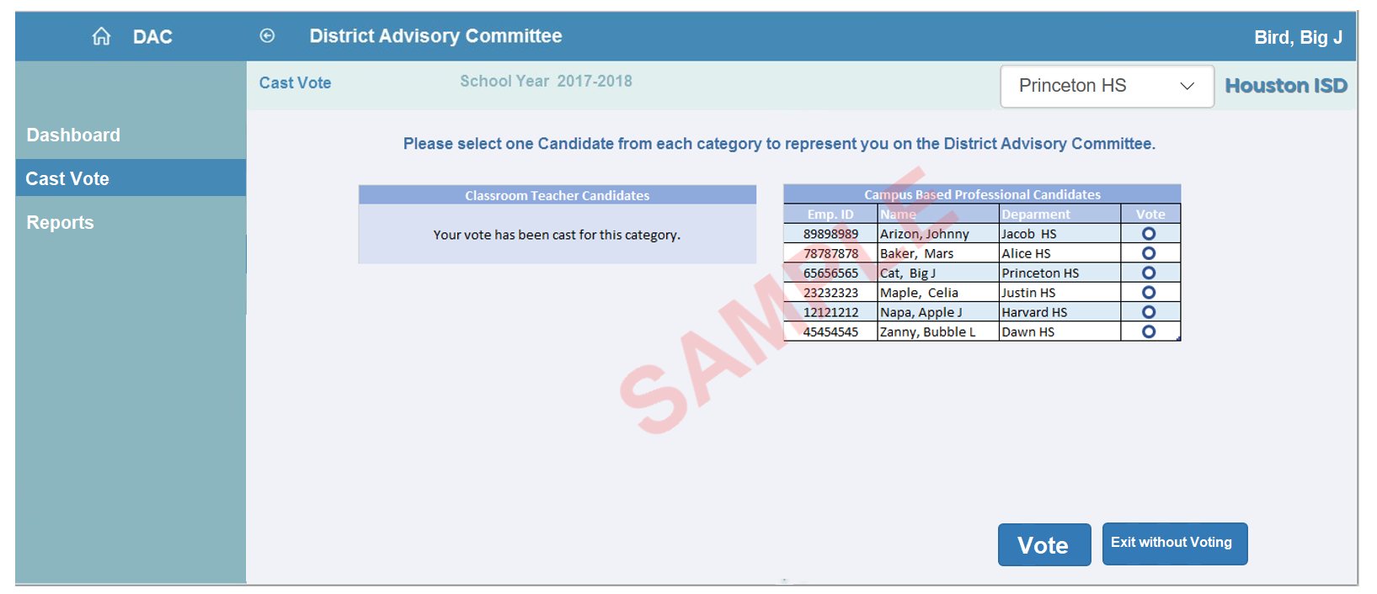
Campus Based Employees-Cast Vote

Slide 19
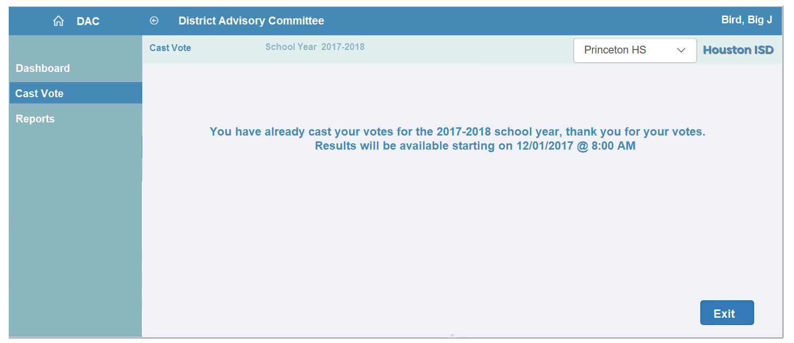
Campus Based Employees-Cast Vote

Slide 20
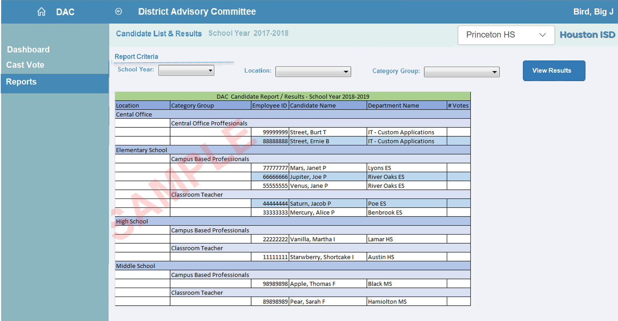
Campus Based Employees-Reports

Slide 21
Central Office Employees

Slide 22
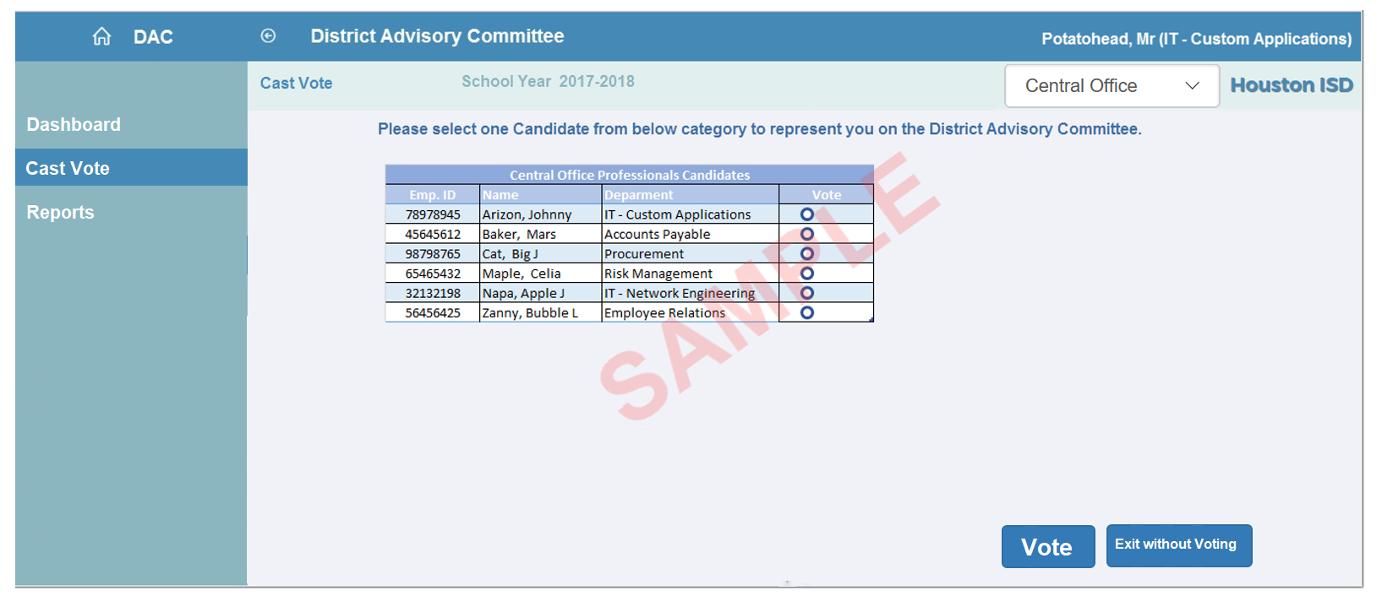
Central Office Employees-Cast Vote

Slide 23
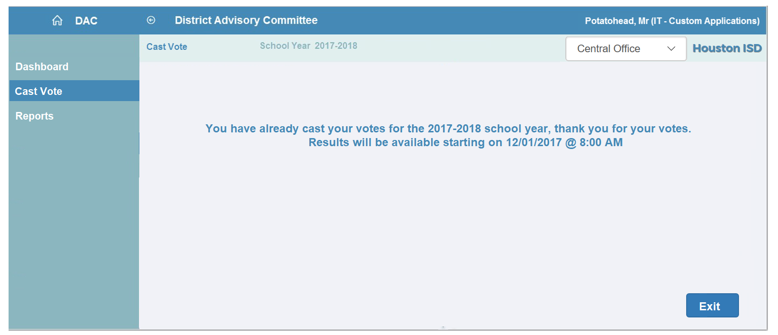
Central Office Employees-Cast Vote

Slide 24
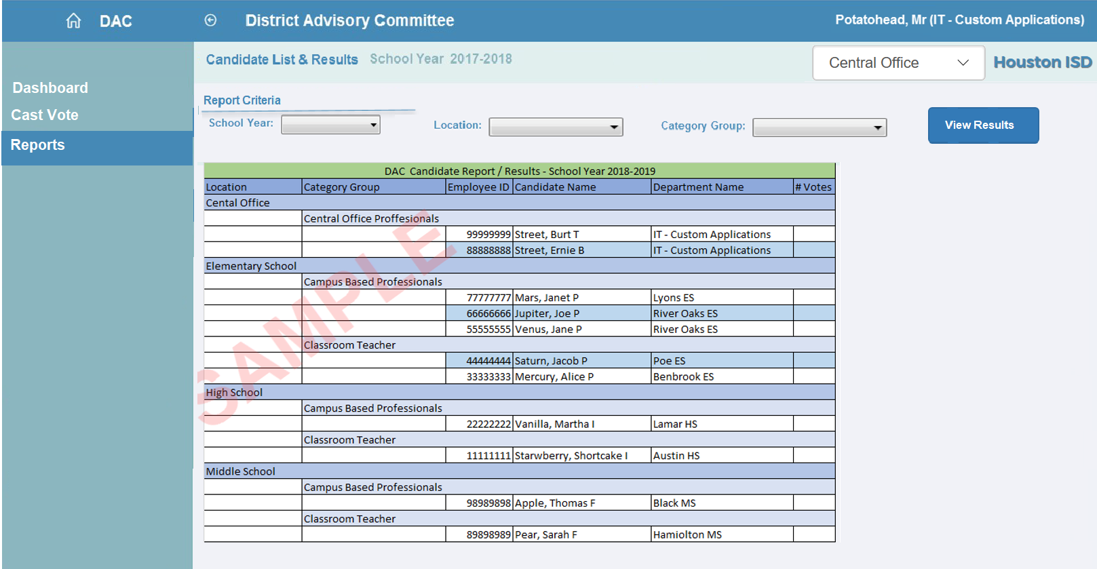
Central Office Employees-Reports

